Slide 1
Theoretical & Experimental

Slide 2
Idea
Title
Human Diffuse large B cell lymphoma cell lines
Description
We have analyzed by label free mass spectrometry the whole cells and secreted extracellular vesicles (EVs) proteomes of two different molecular subtypes of DLBCL, germinal center B cell (GCB subtype) and activated B cell (ABC subtype)
Organism
Homo sapiens (human)
Organism part
B cell
Diseases
Lymphoma

Slide 3
Life cycle
1- plan
Get mass of theoretical by comparing with experimental

Slide 4
2- collect
PRIDE ( PRoteomics IDEntifications Database)
Download dataset (12 file ) -> type ( .Raw)
Human Diffuse large B cell lymphoma cell lines (ebi.ac.uk)
Uniprot
Download ( 1 file ) -> type (.fasta)
SUDS3 - Sin3 histone deacetylase corepressor complex component SDS3 - Homo sapiens (Human) - SUDS3 gene & protein (uniprot.org)
pyOpenMS

Slide 5
3-Assure
check data if it contains Error or No?
Check from Using ( jupyter Notebook)

Slide 6
Steps
1- Download ( 12 file Raw ) and (1 file fasta)
2- Convert extension file .Raw to .Mzml → using software ( proteoWizard)
3- Upload files in jupyter
4- Digestion / fragmentation
Peptide hit sequence
5- Identification
Spectrum
6- comparing
Number of matches
7- show figure plot
Mirror plot

Slide 7
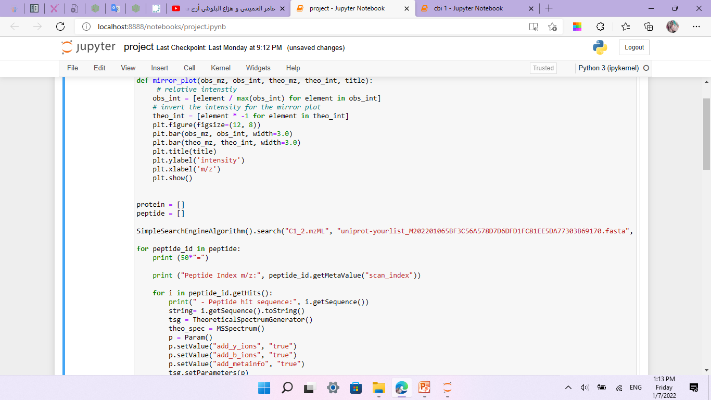
1
SimpleSearchEngineAlgorithm from OpenMS. This makes it very easy to search an (experimental) mzML file against a fasta database of protein sequences

Slide 8
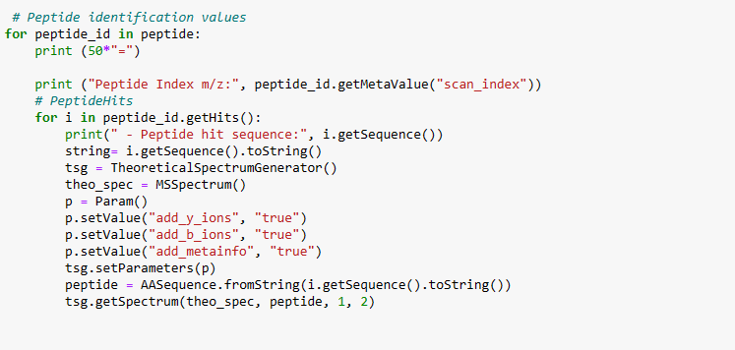
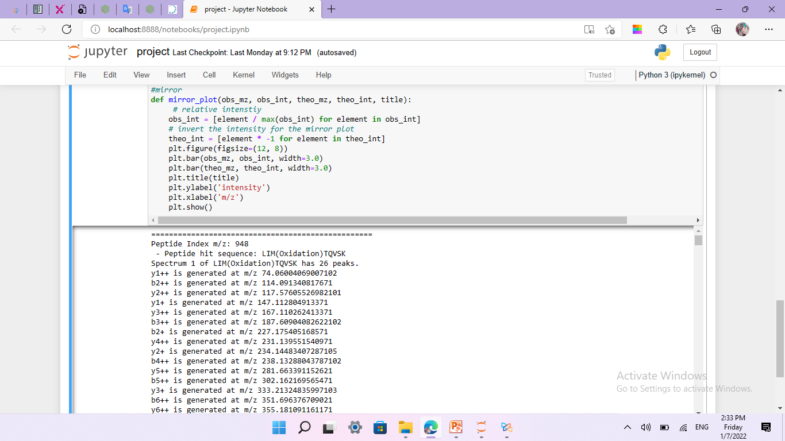
2
we store the peptide and protein identification data in a XML file (a OpenMS internal file format which we have previously discussed here)
input
output

Slide 9
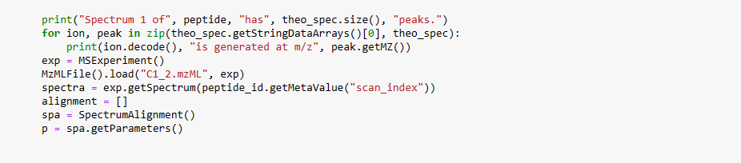
3 -input
We generate the theoretical spectrum of that peptide:

Slide 10
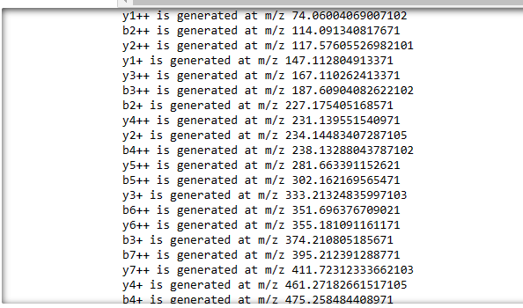
3 -output
which outputs all peaks that are generated (this is without isotopic peaks), here we will just show the first few peaks

Slide 11
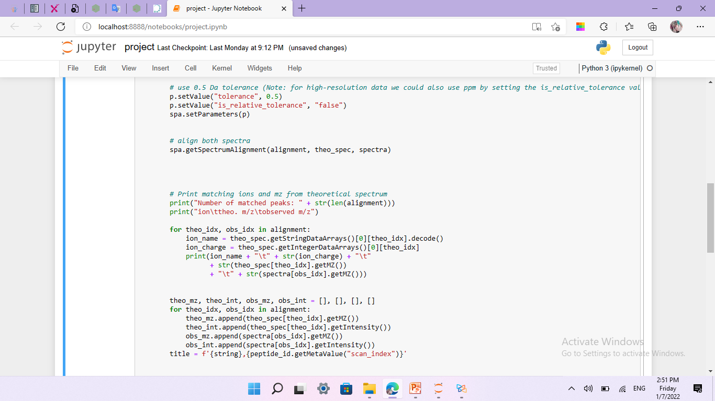
4- input
Find the matching peaks between observed and theoretical spectrum

Slide 12
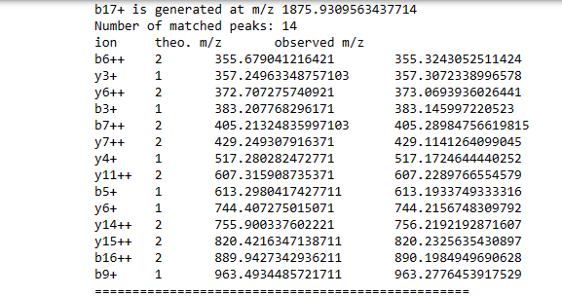
4 - output
which outputs all peaks that are generated (this is without isotopic peaks), here we will just show the first few peaks

Slide 13
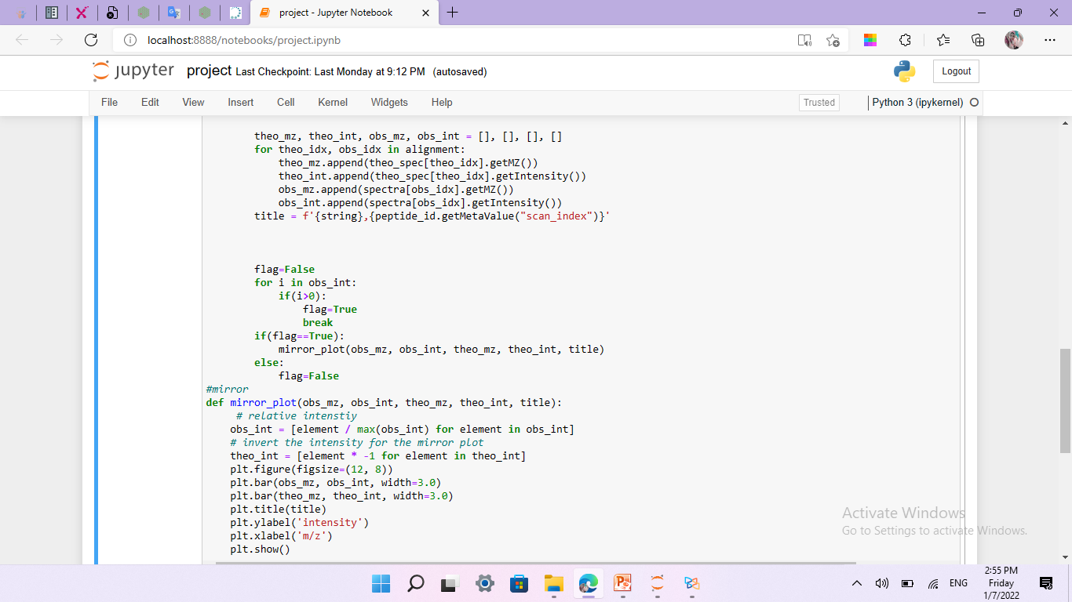
5- input
visualize the aligned spectrum Using The mirror plot

Slide 14
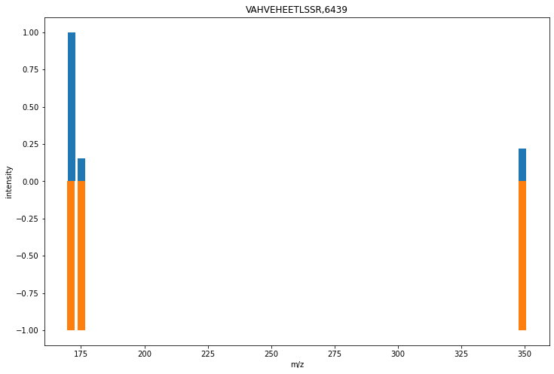
5 -output
C1_2.mzML
which outputs all peaks that are generated (this is without isotopic peaks), here we will just show the first few peaks

Slide 15
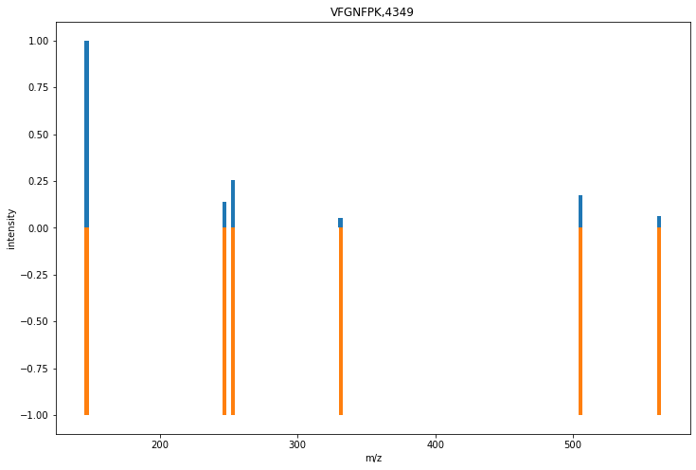
5 -output
which outputs all peaks that are generated (this is without isotopic peaks), here we will just show the first few peaks

Slide 16
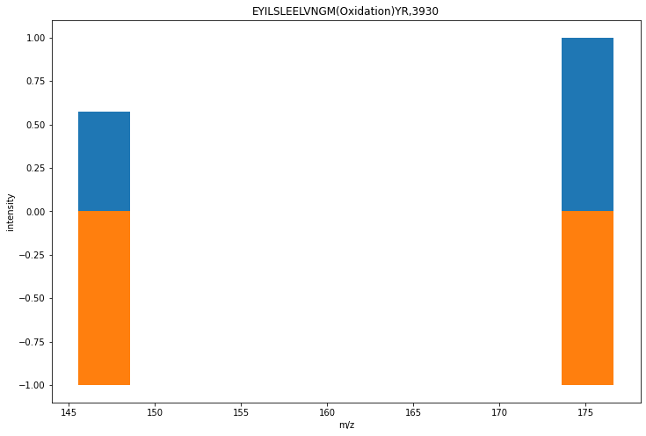
5 -output
which outputs all peaks that are generated (this is without isotopic peaks), here we will just show the first few peaks

Slide 17
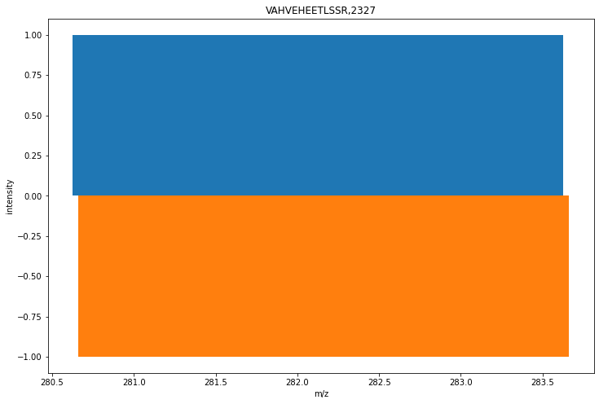
5 -output
which outputs all peaks that are generated (this is without isotopic peaks), here we will just show the first few peaks

Slide 18
5 -output
which outputs all peaks that are generated (this is without isotopic peaks), here we will just show the first few peaks

Slide 19
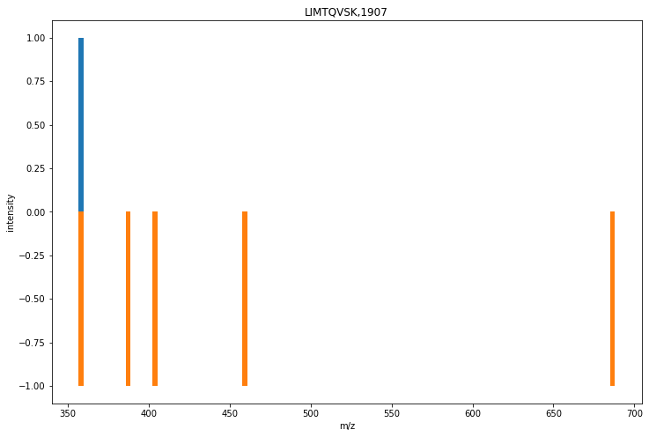
5 -output
which outputs all peaks that are generated (this is without isotopic peaks), here we will just show the first few peaks

Slide 20
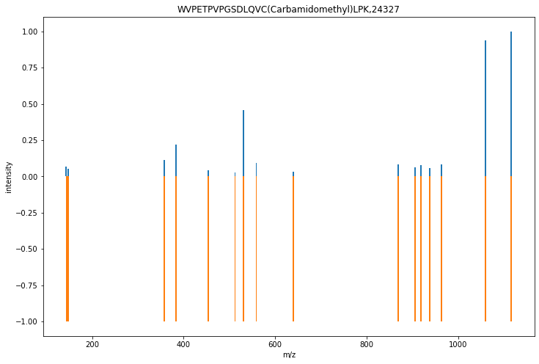
5 -output
which outputs all peaks that are generated (this is without isotopic peaks), here we will just show the first few peaks

Slide 21
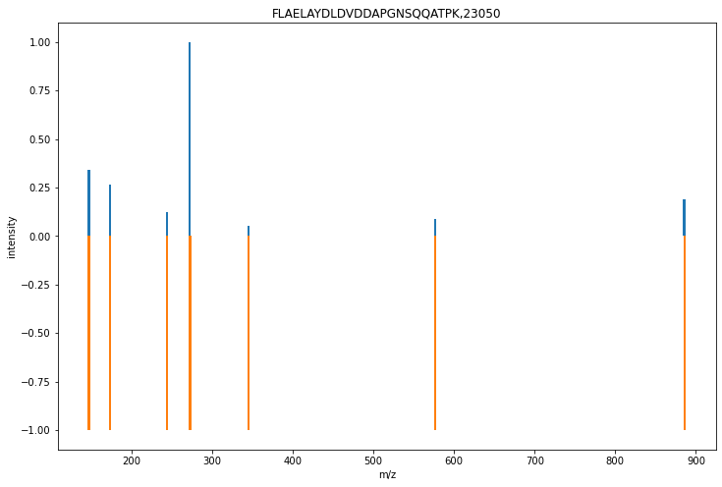
5 -output
which outputs all peaks that are generated (this is without isotopic peaks), here we will just show the first few peaks

Slide 22
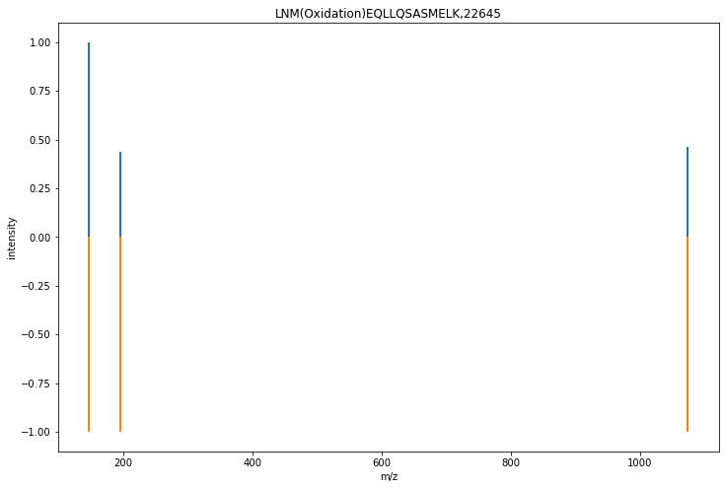
5 -output
which outputs all peaks that are generated (this is without isotopic peaks), here we will just show the first few peaks

Slide 23
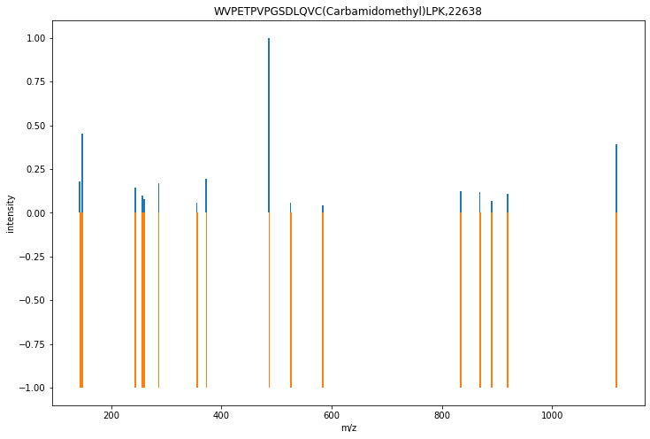
5 -output
which outputs all peaks that are generated (this is without isotopic peaks), here we will just show the first few peaks

Slide 24
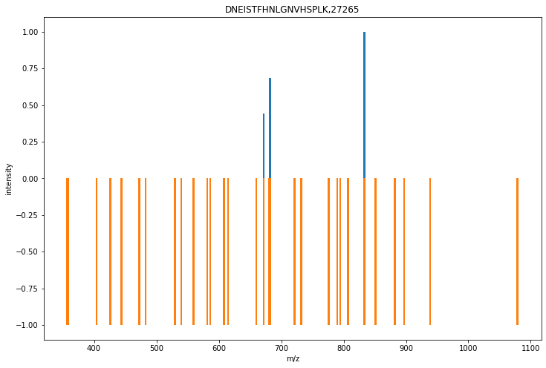
A1_2.mzML

Slide 25
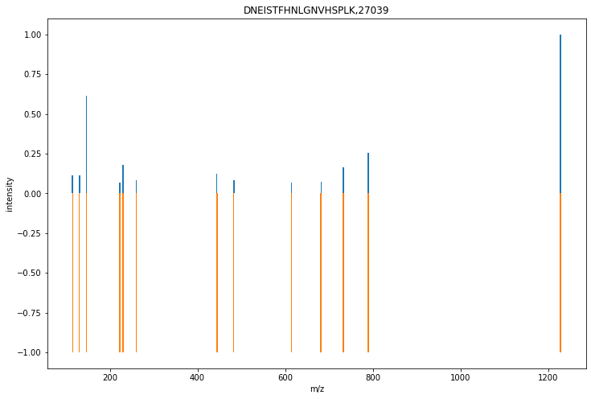

Slide 26
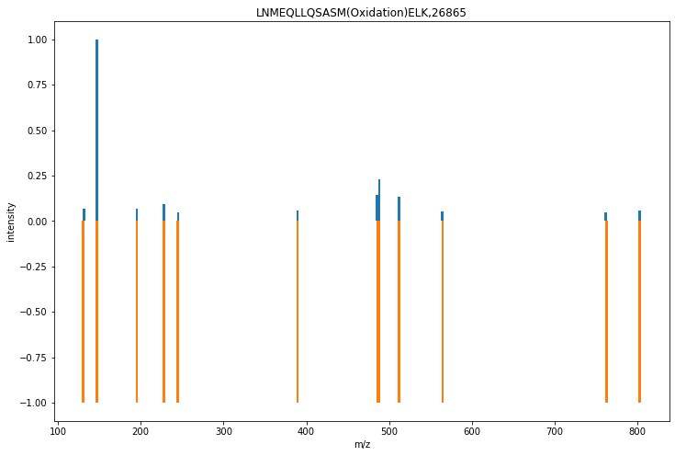

Slide 27
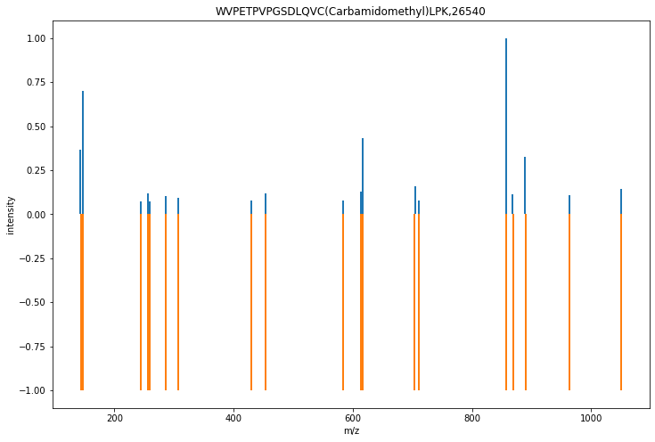

Slide 28
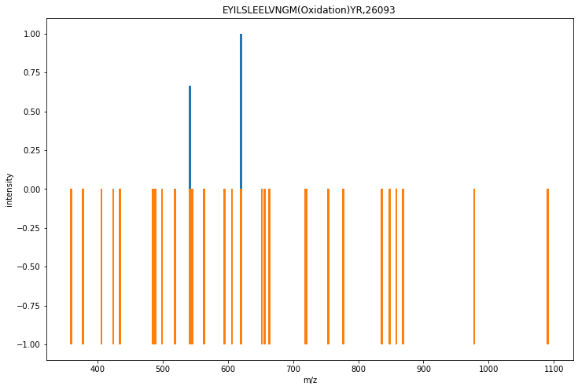

Slide 29
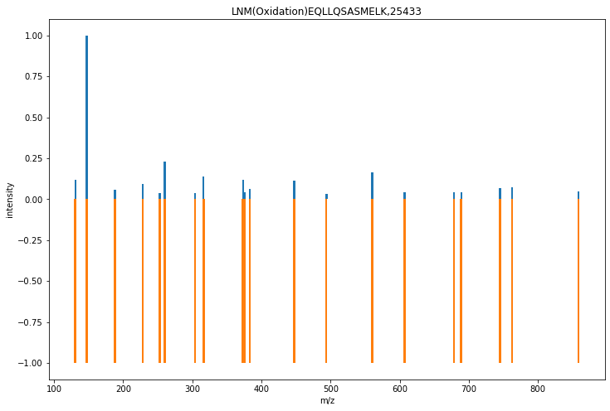

Slide 30

C2_1.mzML

Slide 31
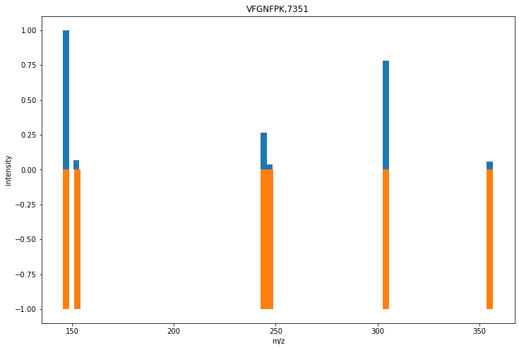

Slide 32
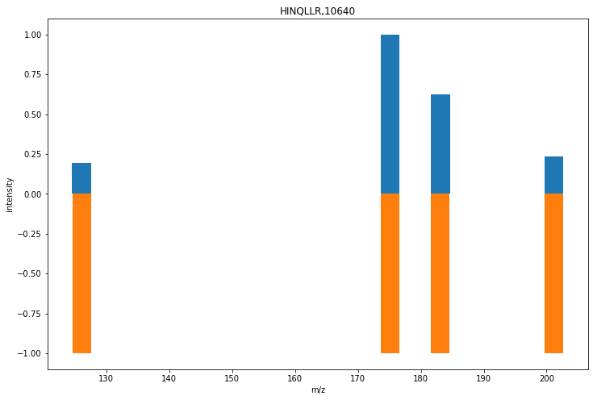

Slide 33
Thank you

